Slide 1
Euler’s function

Slide 2
Euler’s function
In number theory, Euler's function counts the positive integers up to a given integer n that are relatively prime to n.
Written using the Greek letter phi as φ(n) or ϕ(n).
In other words, it is the number of integers k in the range 1 ≤ k < n for which the greatest common divisor gcd(n, k) is equal to 1․

Slide 3
Euler’s function
For example, the let’s compute φ(9)։
gcd(9, 1) = gcd(9, 2) = 1
gcd(9, 3) = 3
gcd(9, 4) = gcd(9, 5) = 1
gcd(9, 6) = 3
gcd(9, 7) = gcd(9, 8) = 1
There are the six numbers 1, 2, 4, 5, 7 and 8 that are relatively prime to 9.
So φ(9) = 6.
If n is prime, then φ(n) = n – 1.

Slide 4
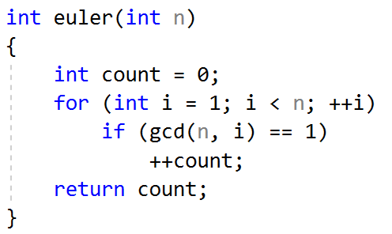

Euler’s function Calculation
Simple solution is to calculate gcd for each number from 1 to n.
Code:
Complexity is $O(n∙\log{n})$. φ(${10}^{8}$) is calculated in 11 seconds.

Slide 5
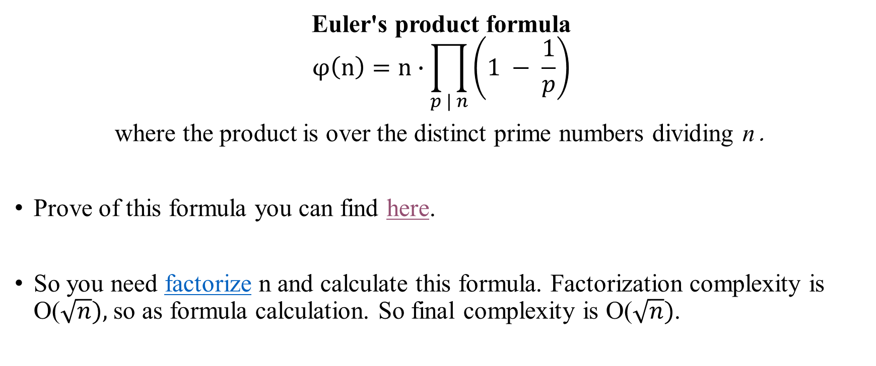
Euler’s function Calculation
Euler's product formula
$$φ\left(n\right)=n∙\prod_{p | n}{\left(1 − \frac{1}{p}\right)}$$
where the product is over the distinct prime numbers dividing n․
Prove of this formula you can find here.
So you need factorize n and calculate this formula. Factorization complexity is O($\sqrt{n}),$ so as formula calculation. So final complexity is O($\sqrt{n})$.

Slide 6
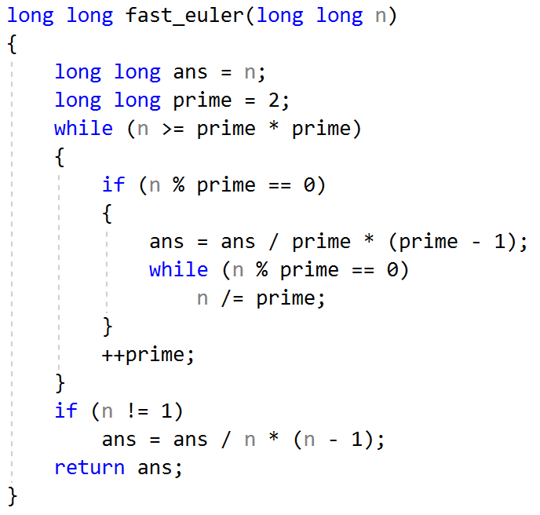

Euler’s function Calculation
Code:
φ(${10}^{8}$) is calculated in 1 msec.

